Slide 1
2024 High School Baseball Rules, Simplified & Illustrated
Published by National Federation of State High School Associations.
All images & and text are copied directly from this Manual
Part 3 Rule 6

Slide 2
PART 3
Rule 6 Pitching
The pitch can be thrown from either of two basic positions — the windup or the set position. This rule explains the pitcher’s positioning and what he can do from each of those positions.
Just as important, however, are the things a pitcher cannot do, either from one of the two positions, or at any time, regardless of whether he is using the set or windup. There are 20 infractions listed that a pitcher could commit, with penalties ranging from a warning to ejection.
This rule also explains that while a pitcher is not pitching, he is treated like any other infielder, except that when a ball passes the pitcher, it can still become dead when it strikes an umpire or a baserunner.

Slide 3
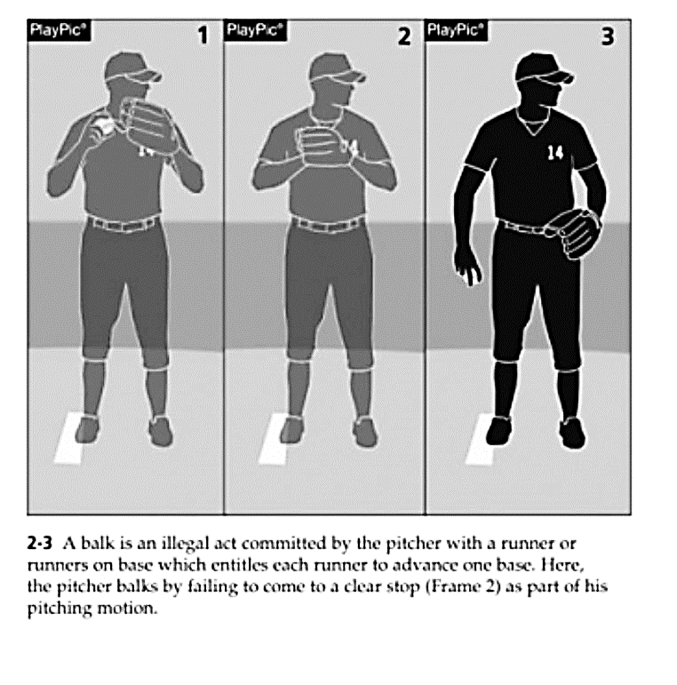
What is a Balk?

Slide 4
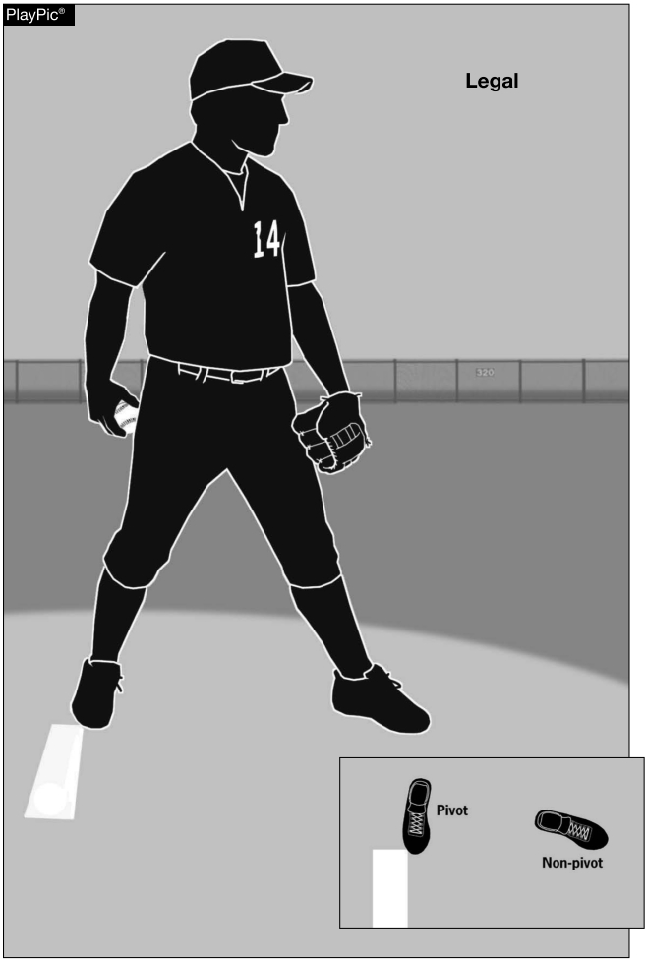
6-1-3 Pitchers are no longer required to have their entire pivot foot in contact with the pitcher’s plate. This change recognizes that many mounds are such that it is problematic for the pitcher to have his entire pivot foot in contact with the pitcher’s plate.

Slide 5
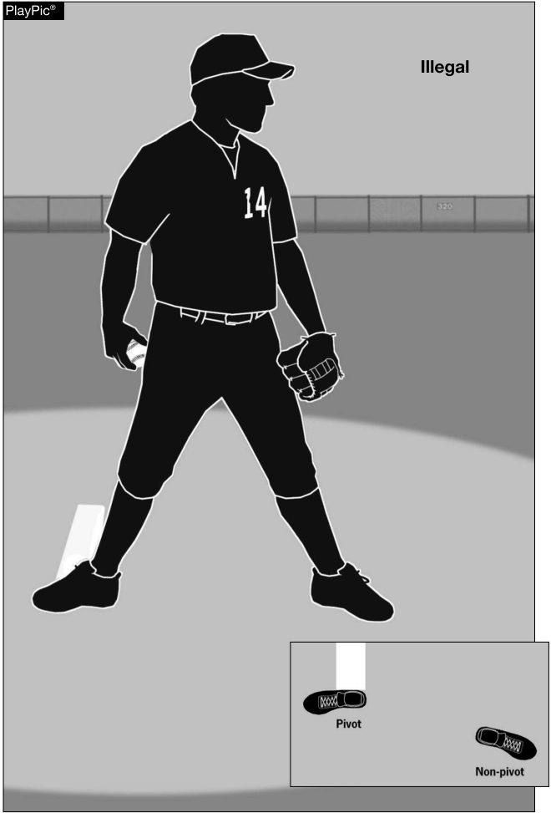
6-1-3 The pitcher shall stand with the pivot foot in contact with or directly in front of and parallel to the pitcher’s plate.

Slide 6
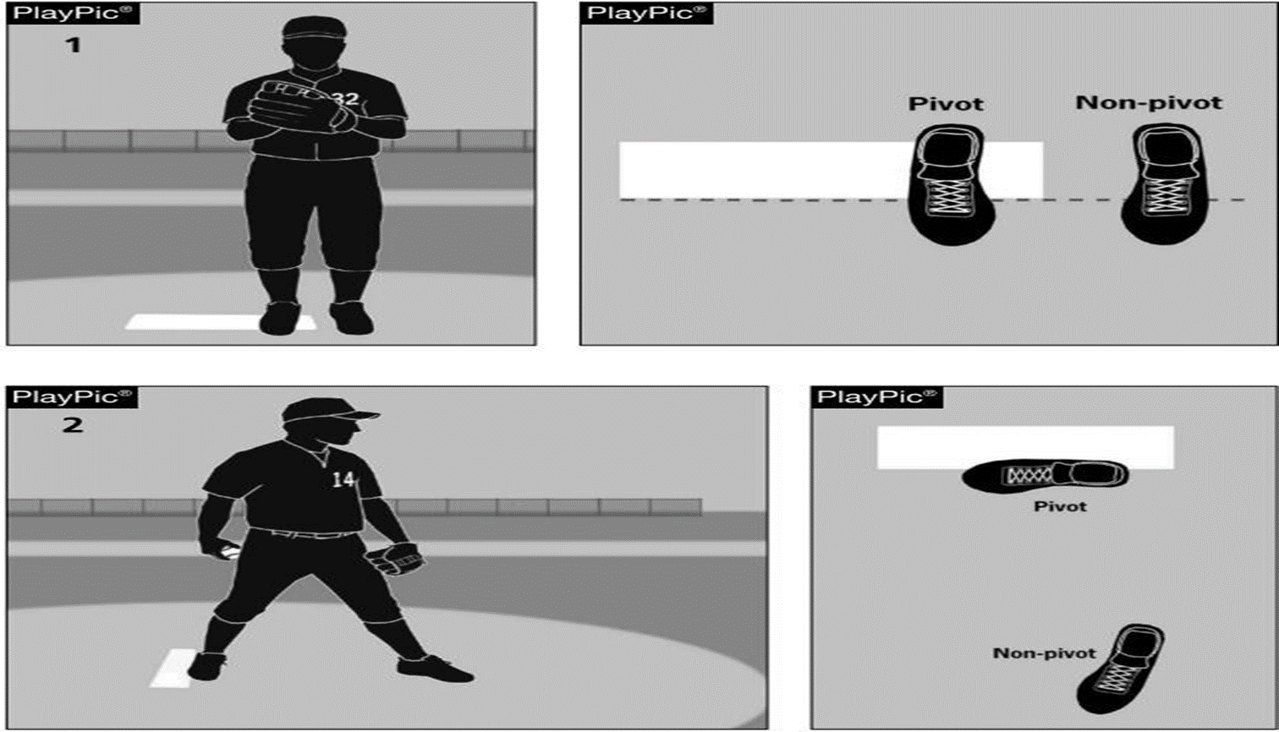
6-1-1 The pitcher shall pitch while facing the batter from either a windup position (Play Pic 1) or a set position (Play Pic 2). The position of his feet determine whether he will pitch from the windup or the set position. The pitcher will be considered to be in the set position when their pivot foot is in contact with or directly in front of and parallel to the pitcher’s plate
.

Slide 7
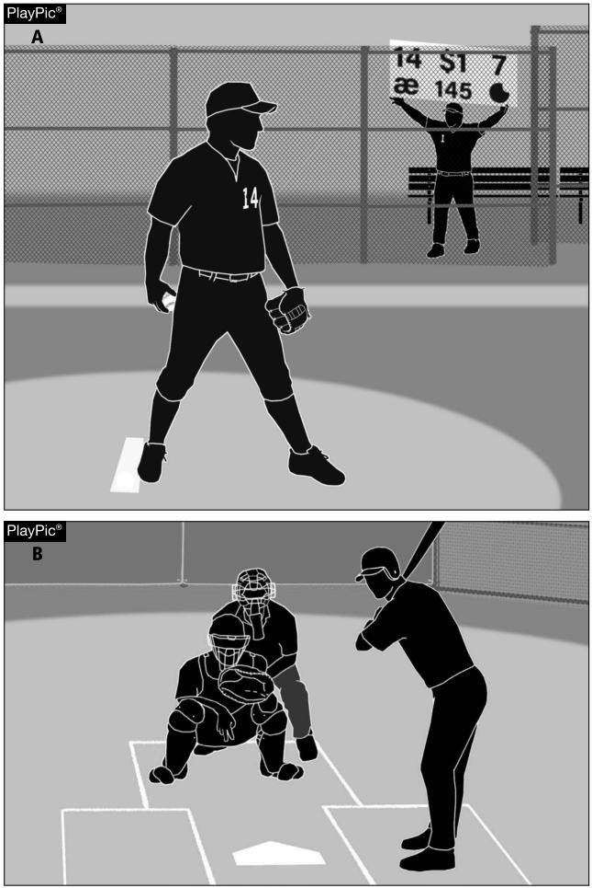
6-1-1 The pitcher shall take or simulate taking his sign from the catcher with his pivot foot in contact with the pitcher’s plate.
This change validates the pitcher taking the sign from the dugout/ bench via “call” signs, numbers, colors, or an arm wristband/ placard that contains printed cards where the defensive set up/ pitching repertoire is located.

Slide 8
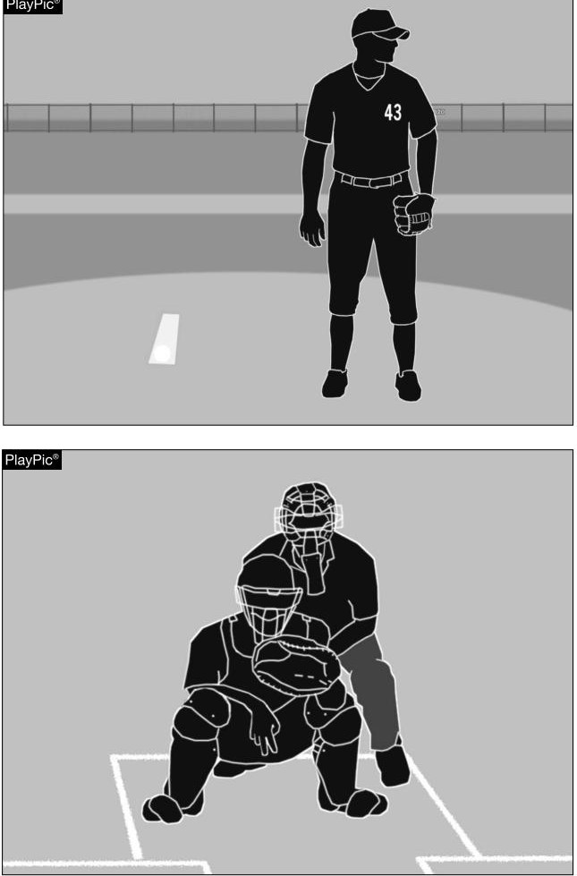
6-1-1 The pitcher shown here is committing a violation by taking his signs from in front of the rubber. Pitchers are required to take their signs from the catcher with his pivot foot in contact with the pitcher’s plate.

Slide 9
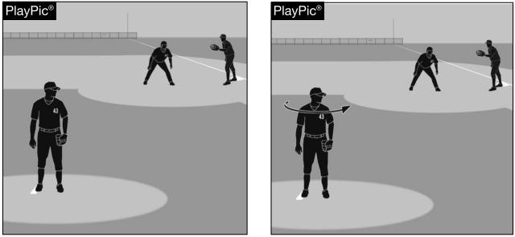
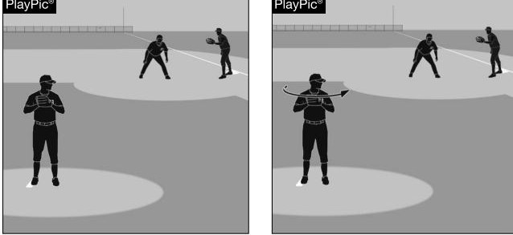
6-1-1 Turning the shoulders to check runners while in contact with the pitcher’s plate in the set position is legal.
6-1-1 Turning the shoulders after bringing the hands together during or after the stretch is a balk.

Slide 10
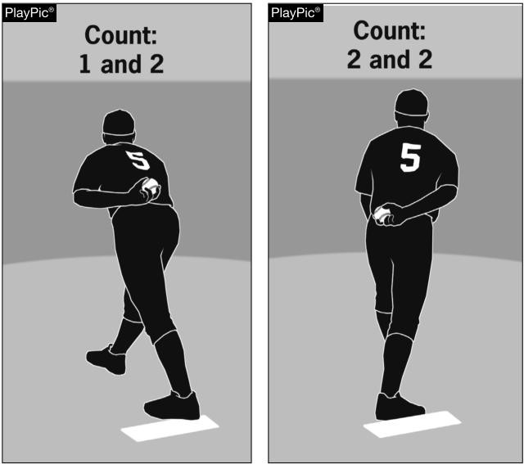
6-1-1 If a pitcher is ambidextrous, the umpire shall require the pitcher to face a batter as either a left- handed pitcher or right- handed pitcher, but not both. This pitcher would not be allowed to switch hands during the middle of a batter’s plate appearance.

Slide 11
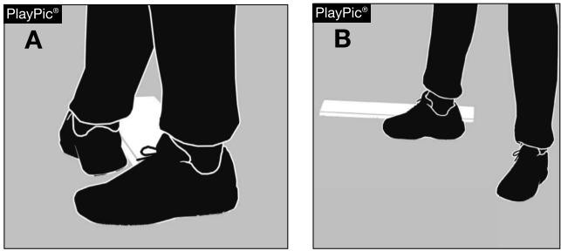
6-1-1, 6-1-2, 6-1-3 No longer will umpires need to enforce penalties against pitchers for using the “hybrid” pitching stance that combined elements of the windup and set positions, as such a stance no longer exists by definition according to NFHS rules.

Slide 12
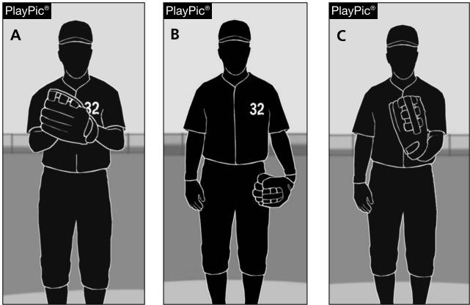
6-1-2 A pitcher assumes the windup position when his hands are: (a) together in front of the body; (b) both hands are at his side; (c) either hand is in front of the body and the other hand is at his side.

Slide 13
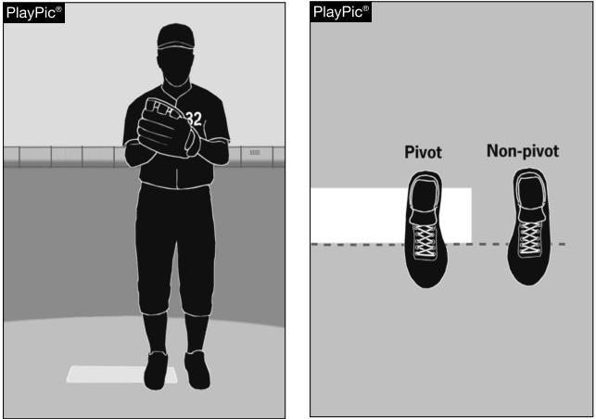
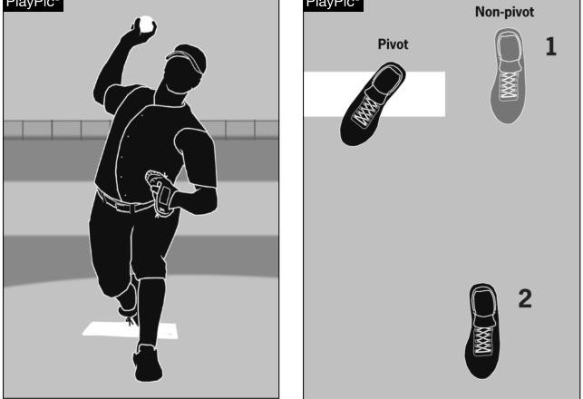
6-1-2 The windup is one of the two legal pitching positions. For the windup, the pitcher’s pivot foot is in contact with the pitcher’s plate and is not parallel to it.
6-1-2 During delivery from the windup position, a pitcher may lift his nonpivot foot in a step forward, with no other steps, and throw a pitch. Once he has moved his non- pivot foot, he is committed to pitch.

Slide 14
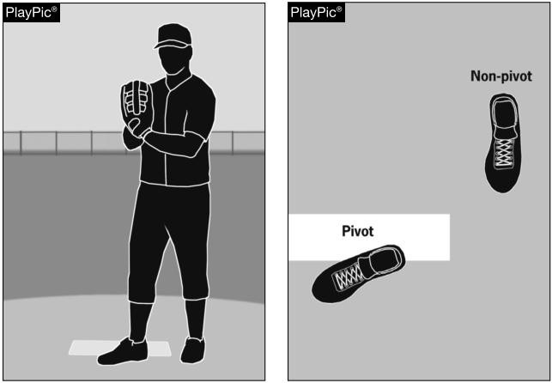
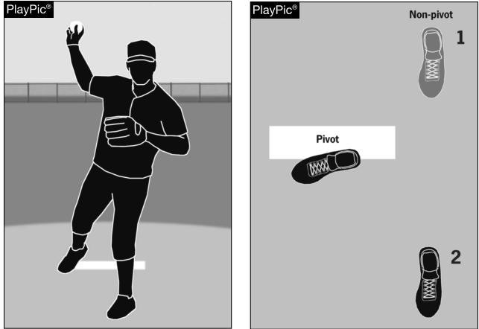
6-1-2 During delivery from the windup position, the pitcher may begin the pitching motion with a step backward. Once he has moved his non- pivot foot, he is committed to pitch.
6-1-2 The most common move for a pitcher from the windup position is a step backward and then a step forward. This is a legal move; however, he is committed to pitch when he moves his non- pivot foot.

Slide 15
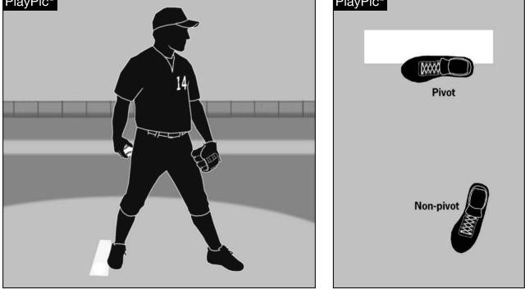
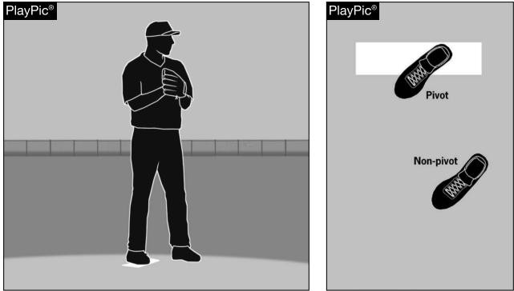
6-1-3 The set is one of two legal pitching positions. For the set position, a pitcher shall stand with the pivot foot in contact with or directly in front of and parallel to the pitcher’s plate.
6-1-3 A number of pitchers are starting in this position and coming set.
Pitcher is in Windup if he comes set Ball or Balk

Slide 16
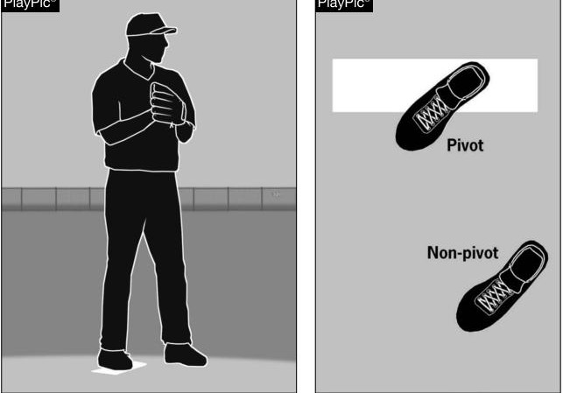
6-1-1, 6-1-2, 6-1-3 The pitcher will be considered to be in the windup position when their pivot foot is in contact with the pitcher’s plate and not parallel to it.

Slide 17
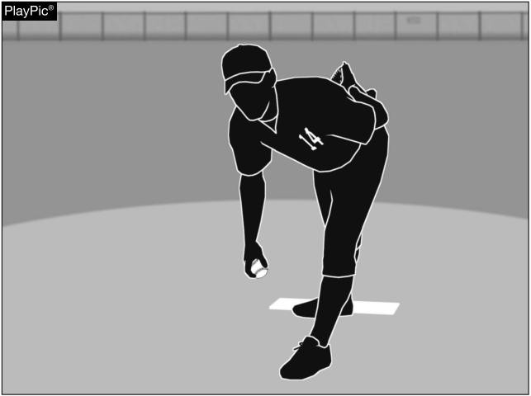
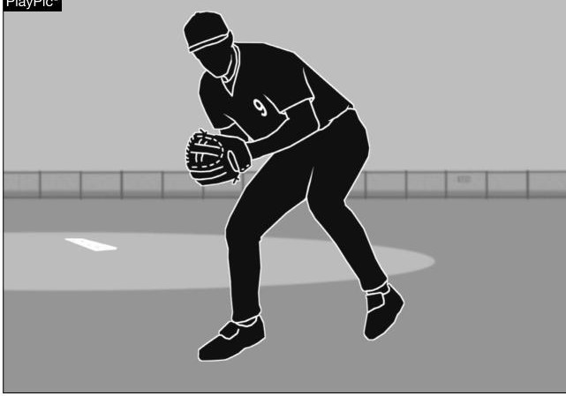
6-1-3 As long as his arm is not swinging, the pitcher is allowed to have his arm hanging by his side. Any swinging motion of the arm constitutes the beginning of the pitching motion. Ball or Balk
6-1-5 A ball thrown by a pitcher when his pivot foot is not on the rubber is treated as if it was thrown by an infielder.

Slide 18
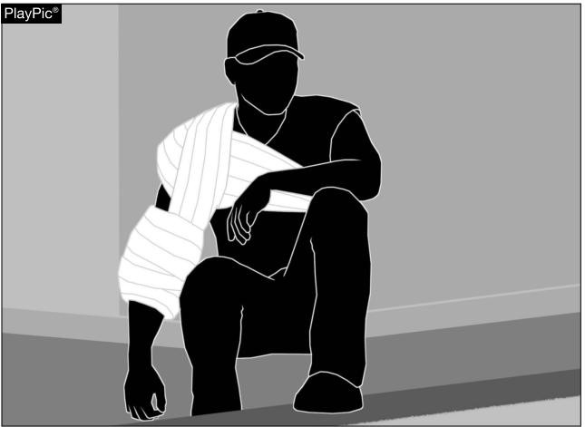
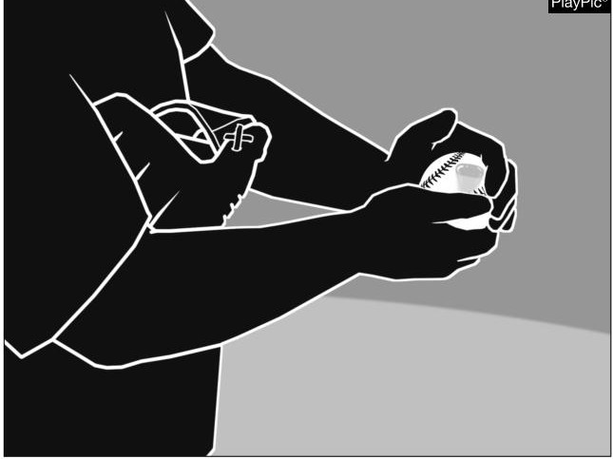
6-1-6 Each state association shall have a pitching restriction policy based on the number of pitches thrown to afford pitchers a required rest period between pitching appearances. Not are concern
6-2-1a A pitcher may not apply a foreign substance to the ball Balk Ball

Slide 19
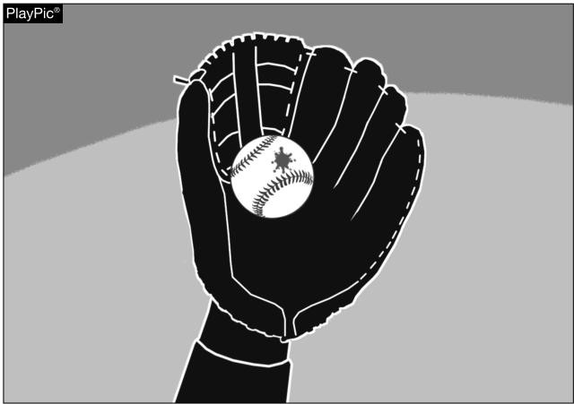
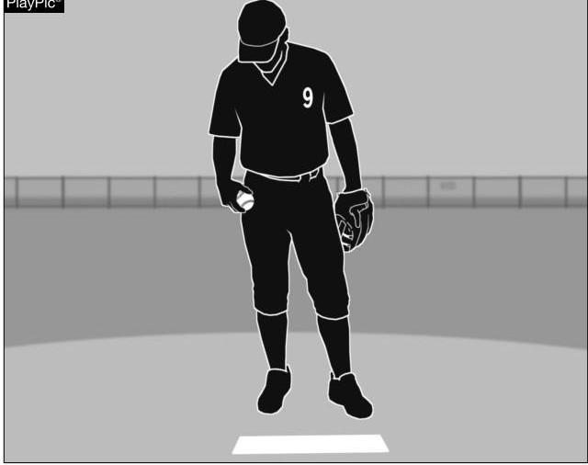
6-2-1b Spitting on the ball or glove is illegal. Balk
6-2-1c Rubbing the ball on the glove, clothing or person is illegal if the act defaces the ball. Balk

Slide 20
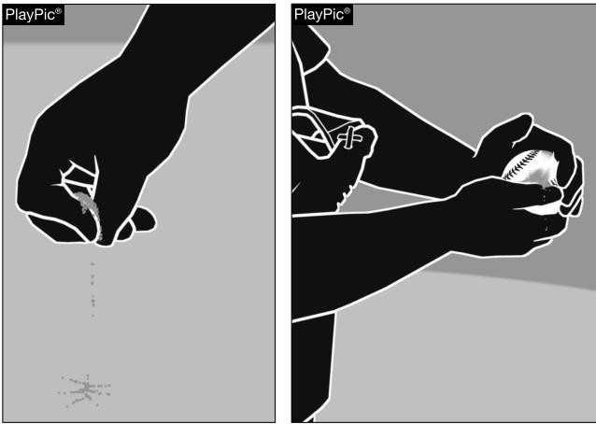
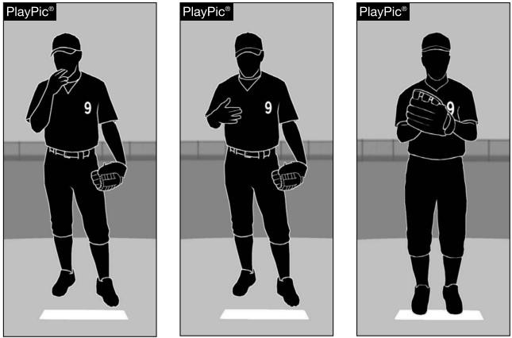
6-2-1d The pitcher may not discolor the ball with dirt. He may rub the ball with his bare hands to remove any extraneous coating. Balk w/ runners
6-2-1e The pitcher shall not bring the pitching hand in contact with the mouth without distinctly wiping off the pitching hand before it touches the ball. The pitcher shown here has not done anything illegal, because he wiped his pitching hand off before it touched the ball.

Slide 21
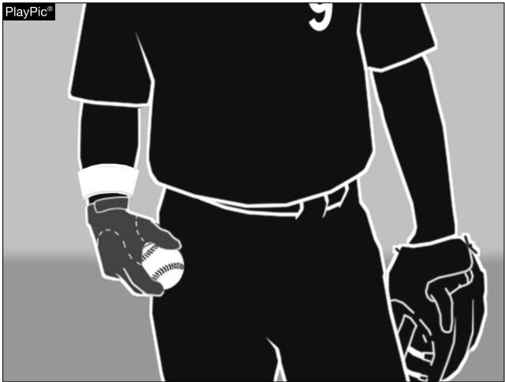
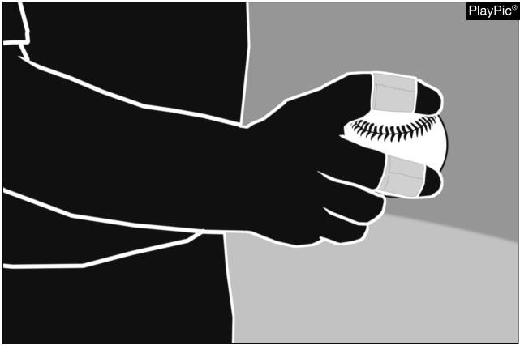
6-2-1f Pitchers may not wear anything on their hands, wrists or arms that may be distracting to the batter.
6-2-1g The pitcher shall not wear tape, bandages or other foreign material (other than rosin) on the fingers or palm of his pitching hand that could come in contact with the ball.
Correct before next pitch

Slide 22
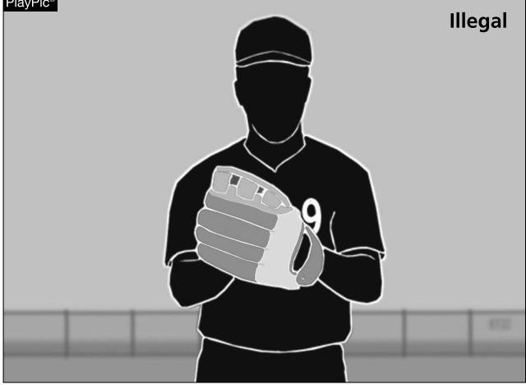
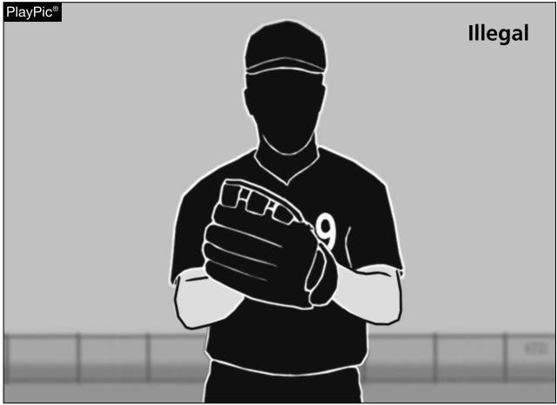
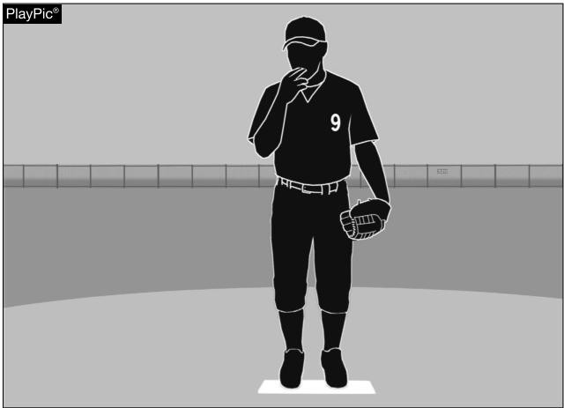
6-2-1h The pitcher may not wear a glove or mitt that includes the colors white or gray. (DDT)
6-2-1i The pitcher shall not wear an exposed undershirt with long sleeves that are white or gray. (DDT)
6-2-1 Penalty. A balk, with (runners on base), or an illegal pitch (with no runners on) is called anytime that a pitcher goes to his mouth while on the pitching plate.

Slide 23
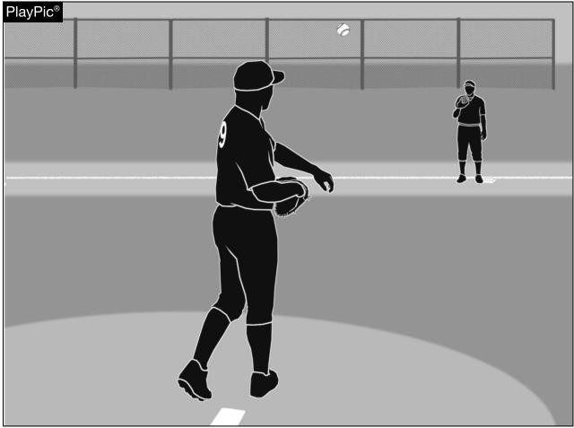
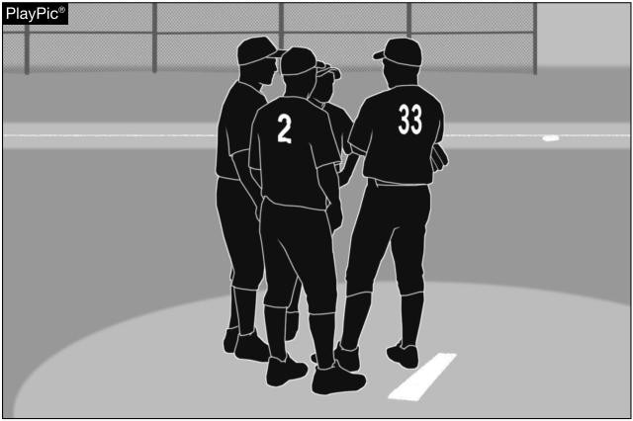
6-2-2a The pitcher shall not throw to any player other than the catcher when the batter is in the batter’s box, unless it is an attempt to retire a runner. This throw to an unoccupied base is illegal (1.warning 2. Ejection), unless there is no possible play at the base.
6-2-2b Once a defensive team has been charged with three conferences, any further meetings are a delay of the game, and the pitcher must be replaced.

Slide 24
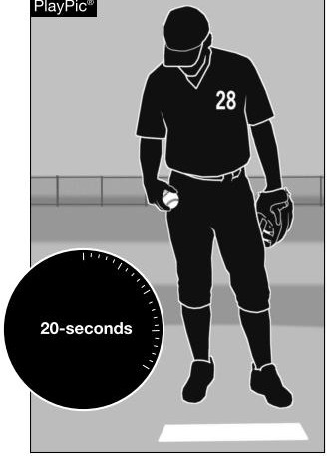
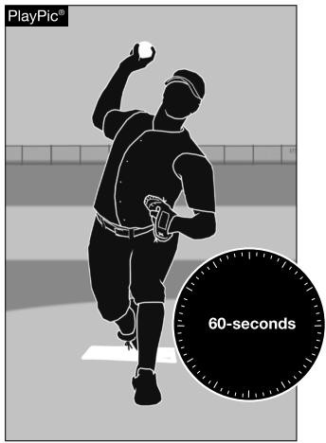
6-2-2c A pitcher must pitch or make or attempt a play, including a legal feint, within 20 seconds after he has received the ball.
6-2-2c Except. A pitcher must complete his warm- up pitches within one minute timed from the first throw or from the third out of the previous half- inning.

Slide 25
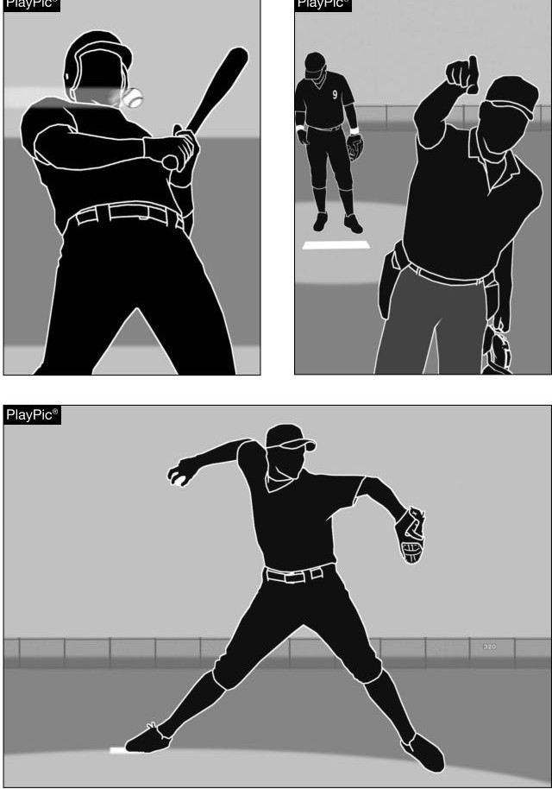
6-2-2c Exception When replacing a pitcher who was ejected, the substitute pitcher should be afforded the same warmup criteria as he would if replacing an injured pitcher. Extra throws may be authorized by the umpire- in- chief.

Slide 26
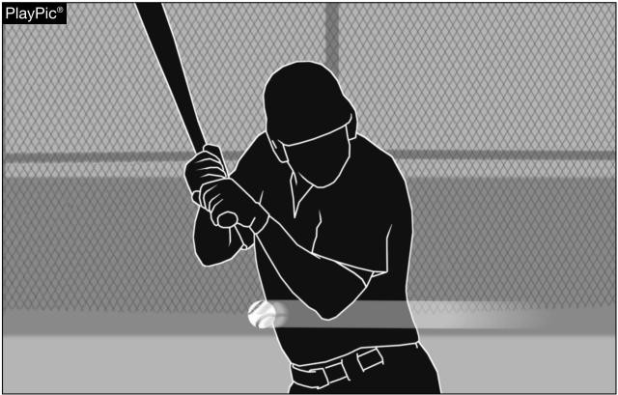
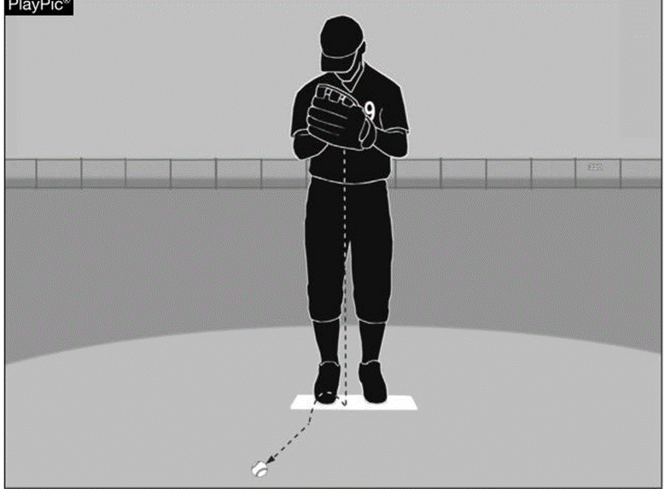
6-2-3 The penalty for pitching intentionally close to a batter has not changed. The pitcher shall be ejected if the pitch is judged to be intentional. In case of doubt, the umpire may warn the pitcher
6-2-4a When the pitcher drops the ball (even accidentally) and the ball does not cross a foul line, he has committed a balk if there are runner(s) on base.

Slide 27
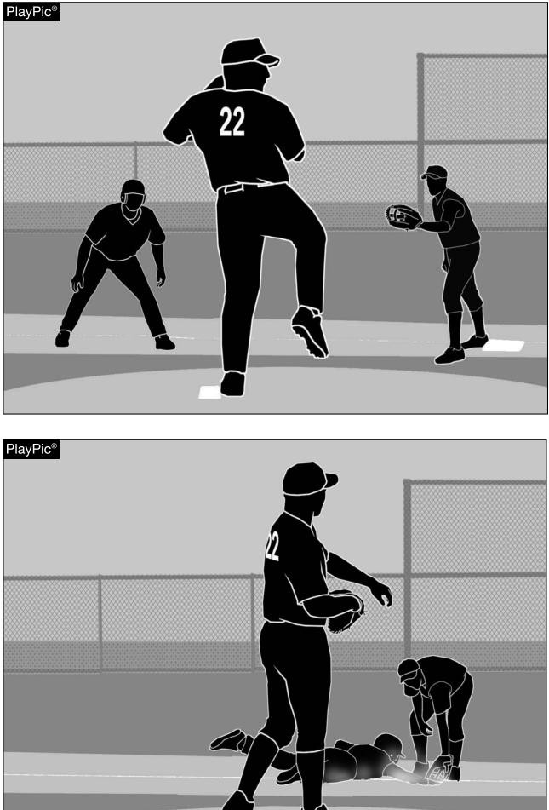
6-2-4b The pitcher has committed a balk because he did not step directly toward first base when he attempted to pick off the runner.

Slide 28
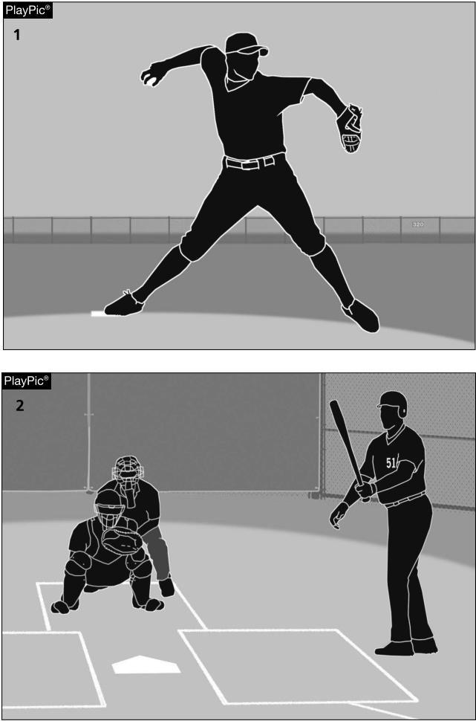
6-2-4d Once the pitcher has started any movement of any part of the body such as he habitually uses in his delivery, (PlayPic 1) he must complete the pitch. Failure to do so with runner(s) on base is a balk. However, if the pitcher stops or hesitates because the batter requests time or steps out of the batter’s box (PlayPic 2), it is not a balk.

Slide 29
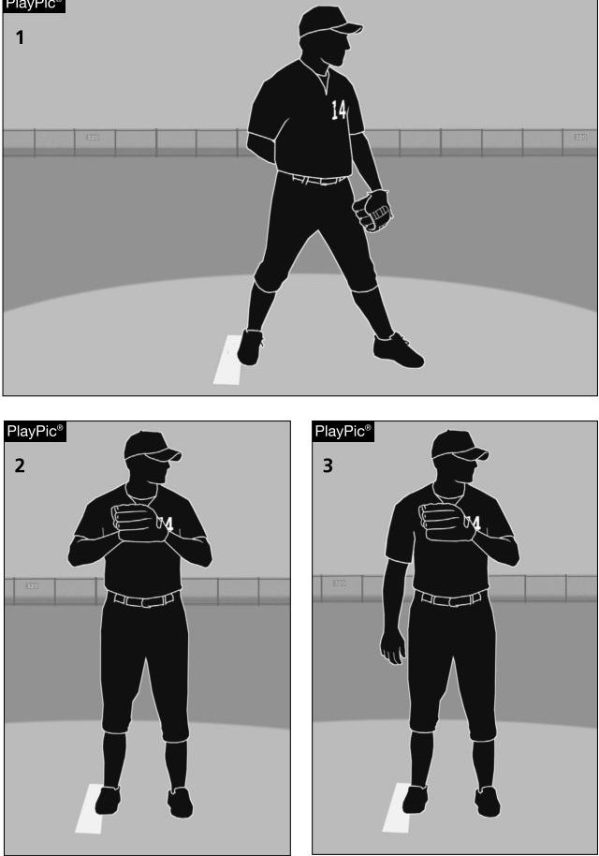
6-2-4e Once a pitcher in the set position has come to a stretch, he may not take his hand out of the glove without the ball, unless he steps off the pitcher’s plate, pitches to the batter, throws to a base or steps toward and feints a throw to second or third base. The pitcher shown here is in the set position (PlayPic 1) and brought the ball and his glove hand together in front of his body legally (PlayPic 2). He then removed his hand from the glove without the ball (PlayPic 3). With a runner on base, this would be a balk.

Slide 30
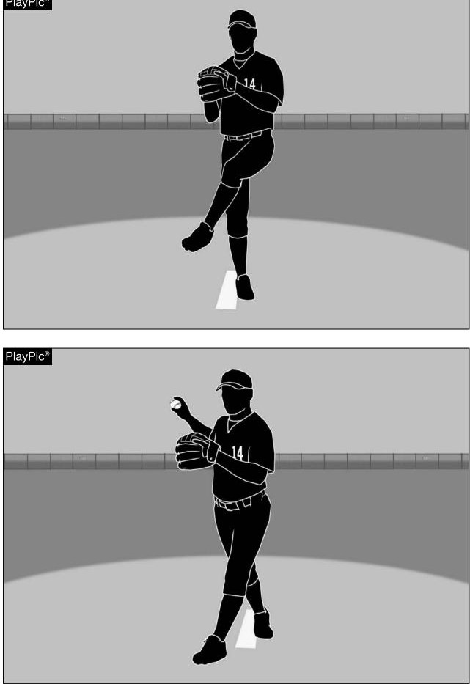
6-2-4f Once the pitcher’s entire non- pivot foot passes behind the perpendicular plane of the back edge of the pitcher’s plate, the pitcher must either pitch or throw/ feint to second base in an attempt to put out a runner. Since this pitcher is throwing or feinting toward third base, this is a balk.

Slide 31

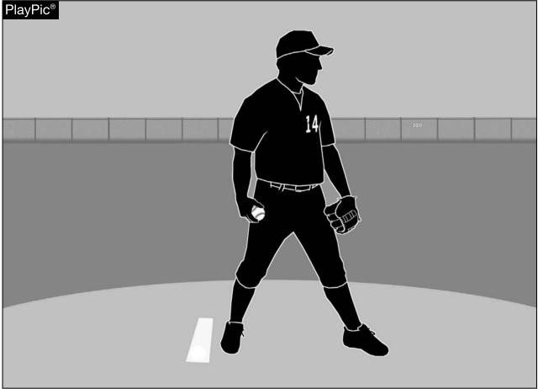

6-2-5 A pitcher may not position himself within approximately five feet of the pitcher’s plate without the ball with a runner(s) on base Balk
6-2-5 If the pitcher makes any movement normally associated with his pitch, such as taking a sign, while not in contact with the rubber, he has committed a balk.

Slide 32
BALKS National Federation of State High School Associations Rules
It is a balk if the pitcher:
Takes his sign when not on the pitching plate. (6-1-1)
In The windup position, pumps or rotates his arms more than twice before delivery. (6-1-2)
Attempts a pickoff move from the windup position. (6-1-2)
Pitches a defaced ball. (6-2-1,a-d)
Delivers the pitch without facing the batter. (6-1-1)
Throws to first or third after his non-pivot foot has broken the plane of the back edge of the pitcher’s plate. (6-2-4f)
Pitches when the catcher does not have both feet in the catcher’s box. ((6-1-1)
Assumes the set position, without keeping his pitching hand at his side or behind his back. (6-1-3)
Does not come to a complete and discernable stop, with the glove at or below his chin. (6-1-3)
Brings his pitching hand to his mouth and then delivers without wiping off that hand. (6-2-1e)
Interrupt’s his pitching motion, once begun. (6-2-4d)
Pitches from the windup position without maintaining contact with the rubber. (6-1-2)
Make a quick return pitch. (6-1-1)
Steps forward off the rubber from the set position. (6-1-3)
Drop’s the ball while on the rubber when the ball does not cross the foul line. (6-1-4)
Feints toward home. (6-2-4a)
Feints toward first. (6-2-4a)
Fail to step first with the non-pivot foot toward any base before making a throw. (6-2-4b)
Feints or throws to an unoccupied base except when making a play. (6-2-4b)
Fail to pitch after making any motion habitually connected with his delivery. (6-2-4b)
Removes his hand from the ball in the set position except to pitch or throw. (6-2-4e)
Standing on or astride of the pitching plate, or within five feet of it, without the ball. (6-2-5)
After coming to a complete and discernible stop in the set position, turns shoulders or feints with any part of the upper body, except the head. (6-1-1)
Fails to step clearly backward off the pitcher’s plate with his pivot foot first. (6-1-3)
Not having all fielders, except the catcher, with at least one foot on fair ground, at the time of the pitch. (1-1-4)
Fail to take the proper steps or excess steps while delivering the pitch from the wind-up position. (6-1-2)
Note : It is not a balk if with runners on first and third, the pitchers' feints to third and without disengaging, turns, steps and throws to first. (See Case Book 6.2.4sit.c)

