Slide 1

Working the Plate

Slide 2
Plate Stances
Two basic stances
  Box
  Scissor
  There is a third, but few use it
    Knee

Slide 3
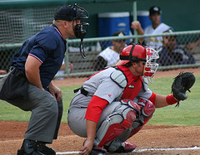
The Box

Slide 4
The BOX
Traditional
Balanced

Slide 5
The Box
Inside Foot Positioning

Slide 6
The Box
Head Positioning

Slide 7
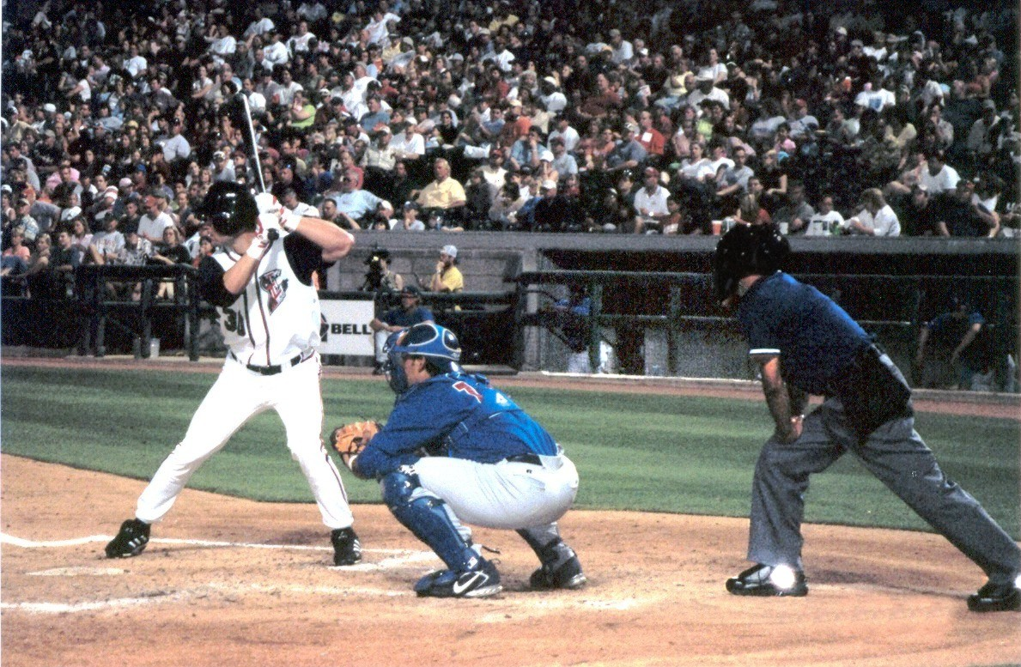
The Scissors

Slide 8
The Scissors

Slide 9
The Scissors
Inside Foot Positioning

Slide 10
The Scissors
Head Positioning

Slide 11
The “SLOT”

Slide 12
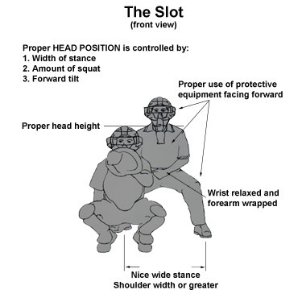
The Slot

Slide 13
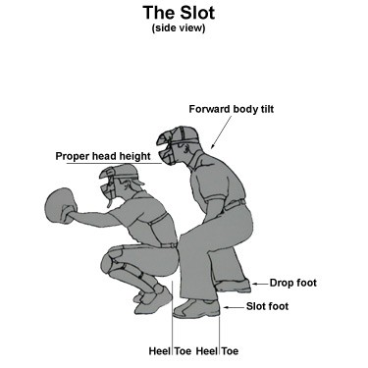
The Slot

Slide 14
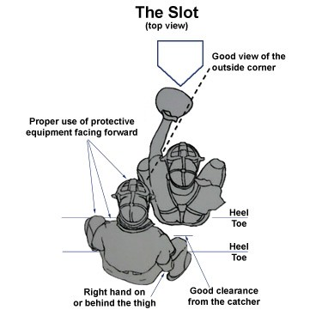
The Slot

Slide 15
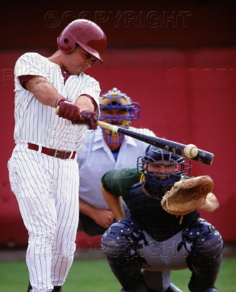
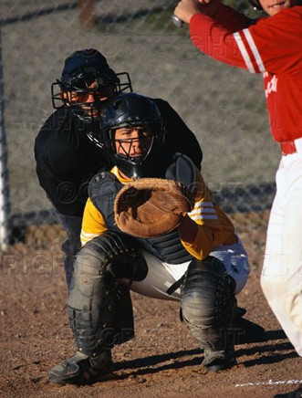
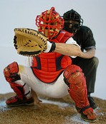
The “SLOT”
Good
Bad
Ugly

Slide 16
Getting into position
On the rubber
Set
  “drop” from A to B
Read it
Watch it
Pause
Call it

Slide 17
Making the call
Ball
Strike
Swinging strike
Third strike
Check swing
Catcher/Batter interference
Dead ball strike

Slide 18
Responsibilities
Balks
Swing/Check Swing
Foul Ball/Foul Tip
Hit batter
Batter not avoiding pitch
Batter ducks, but pitch hits the bat
Batter is out of the box
Batter swings, but is hit by the pitch
Catcher interference
Batter interference
Squeeze play
Passed ball
Dropped third strike

Slide 19
Clearing the Catcher

Slide 20
Popups
Get out of the catcher’s way
Move with the catcher
Watch the glove
Make the call

Slide 21
Positioning for Calls

Slide 22
Positioning for Calls

Slide 23
Problem Areas
Batter crowding the plate
Catcher inside and/or high
Catcher way outside
“That one’s gonna hurt” pitch

Slide 24
The Mask
Hat
Standard Mask
Hockey-style
Removing/Carrying the mask

Slide 25
The Indicator
Absolute necessity
Using/Carrying

Slide 26
Tips for working the plate
Introduce yourself to the catcher
Take pitches from EACH pitcher in the first inning during warmup
Work with the catcher during the game
Use the catcher to assist you with problem pitchers
Home Runs
  Send the catcher to mound with a ball
  Manage the dirt
All pitches are strikes---unless they convince you otherwise
Call the pitch on the knees, but stay away from the high pitch
Consistency during the game is crucial

Slide 27
Questions ?

